Slide 1

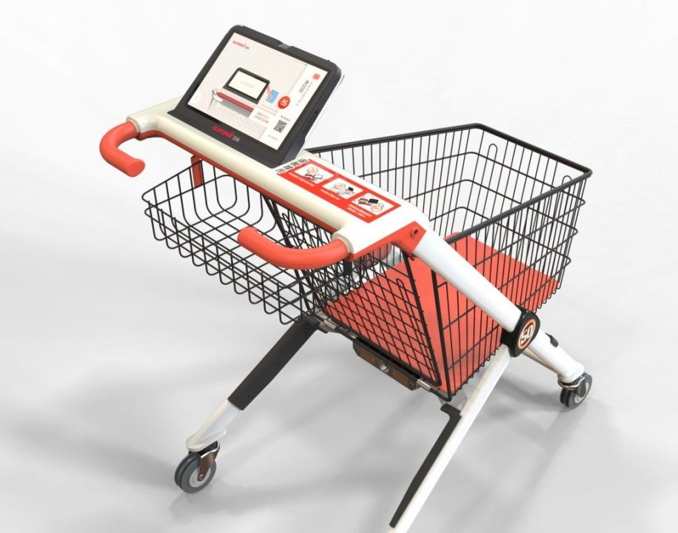
Smart Shopping Cart using IOT &
Google Firebase
Sponsored by – SoftAim Solution Pvt.Ltd.
BE IT
PROF. KAPIL WAGH

Slide 2






Yash Upare
BE 69
Our Team
Vinit Dhas
BE 16
Our team is a diverse group of dedicated individuals, each bringing unique skills in Internet of Things and Deep Learning. Together, we collaborate seamlessly to create innovative solutions, driven by a shared passion for technology and problem-solving.
Aditya Bole
BE 11
Saurabh Pisal
BE 44

Slide 3
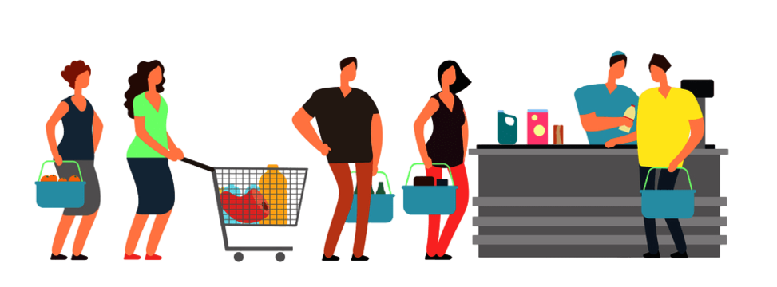
Abstract
Over the past few years, IOT has become one of the most important technologies of the 21st century.
Now that we can connect everyday objects kitchen appliances, cars, thermostats, baby monitors to the internet via embedded devices, seamless communication is possible between people, processes, and things.
Nowadays, buying and searching at huge malls is turning into a daily activity in subway cities.
We can see large rush at malls on holidays and weekends.
The rush is even a lot of once there are special offers and discount.
To minimize the Queue at a billing counter in a shopping complex.
Smart Cart does the same by displaying the total price of the product kept inside the cart.
Recommendation of clothes will be shown on android app.
Collaborative filtering algorithm will be used for recommendation.

Slide 4
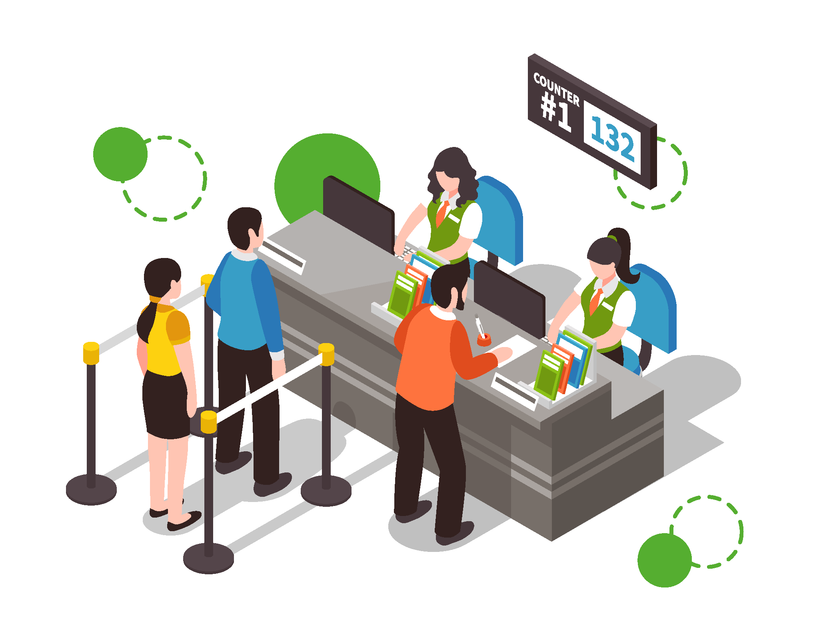
Introduction
Even through e-commence and other online applications are growing rapidly the craze for traditional shopping has never stepped back.
One difficulty is to follow up in a queue for the billing process. There, arises a demand for easy and quick payment of bills.
The proposed Smart Cart, is capable of generating bill using IoT along with the mobile cart application having cloth recommendation.

Slide 5
Objectives
Our aim
The goal
The project aims at the billing automation of purchased products using Smart Shopping cart to minimize the time spent for scanning each product manually using Barcode Scanners with recommendation systems to enhance the customer’s experience at supermarkets and hypermarkets.
Smart shopping cart system that will keep the track of purchased products and also online transaction for billing using RFID and also provides recommendation for certain product category

Slide 6
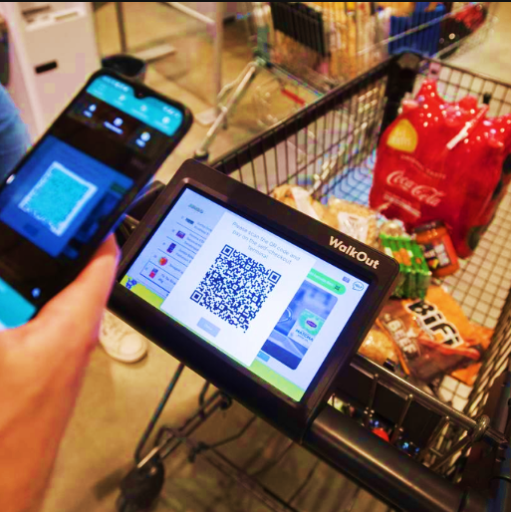
Problem Statement
Shopping mall is a place where most people from all walks of life will get their daily necessities ranging from food product, apparels, toiletries, gardening tools electrical appliances, and others.
Since the entire process of billing is manual it increase the possibility of human error substantially and time is also increased.
Hence to overcome this problem we are creating a smart cart system.

Slide 7
Literature Survey
Name of Author | Year | Title | Description | Gap identified
S Kowshika | 2023 | IoT based Smart Shopping Trolley with Mobile Cart Application | With the use of this mobile application and trolley, customer can make bill payment in no time | Connection require internet. There might be possibility some user can face range issue.
Chandrasekar | 2022 | Smart Cart with Automatic Billing | In this paper they have made a system model where each cart will have an RFID reader and zigbee trans-receiver implemented on it. | System Does not provide any recommendation
Dr. Subburam, Anitha R | 2020 | Smart trolley and billing system | The smart cart uses the RFID tag and receiver to scan the product, load cell to prevent theft, LCD display and the Raspberry pi. | Product cost is more as raspberry pi is used.

Slide 8
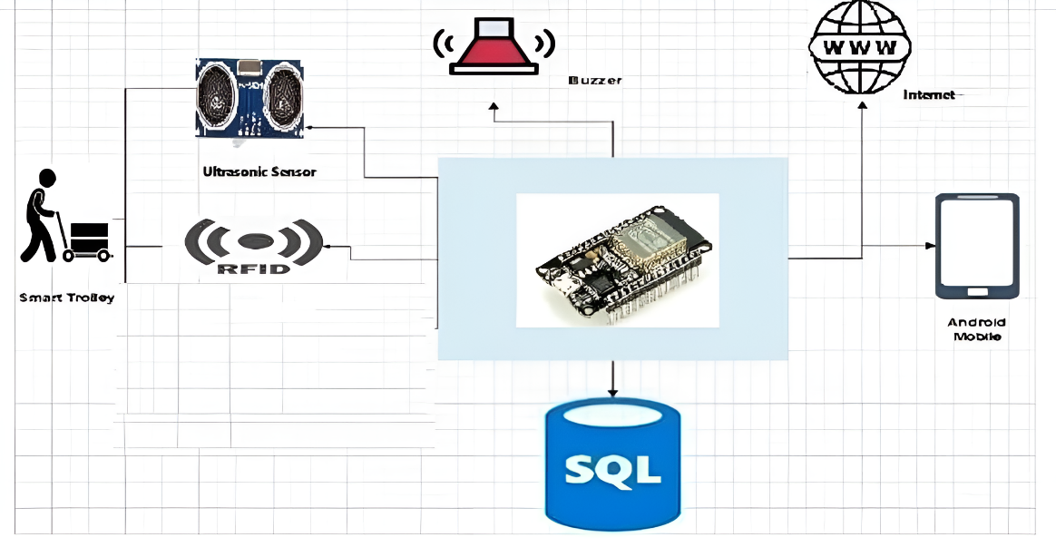





System Architecture

Slide 9
Requirement
Hardware
ESP32
Jumper wire
RFID Reader and Scanner
Software
Operating System: Windows and Linux
Technology: Java 8
Database: MySQL
Android Studio

Slide 10
System Requirement
Hardware
Processor - Core 2 DUO and Above
RAM - Min 1GB
Hard Disk - Min 30 GB
LAN Cable - 4 (Depending upon number of machine)
Camera - Min 2 MP
Software
Operating System: Windows or Linux or Any
Technology: Python, JSP/Servlet
Database: MySQL 5.5
Eclipse Indigo IDE

Slide 11
Functional Requirement
User is able to login in android app using username and password.
User is able to see product in android once he add in cart.
User is able to see product is removed in android once he remove in cart.
User should be able to pay using gpay.
Non-Functional Requirement
Provide login and registration to android app.
Show Image of the product on android app.

Slide 12
Costing
Hardware Components | Quantity | Cost per component
Power Supply[Cell] | 4 | 100.00
ESP32 | 1 | 850.00
RFID Scanner | 1 | 240.00
RFID Tags | As Per Requirement | 20.00
Ultrasonic Sensor | 1 | 210.00
Buzzer | 1 | 50.00
LED | 1 | 2.00
Connecting wires | AS Required | 10.00

Slide 13
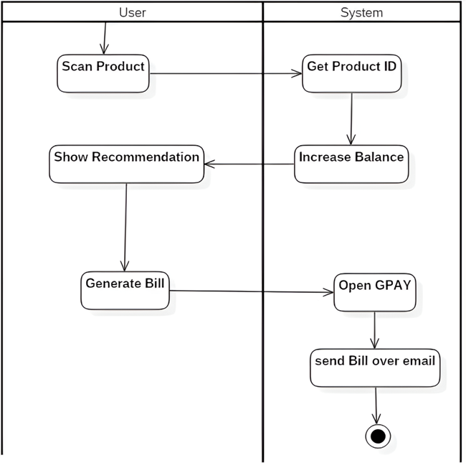


Activity Diagram :

Slide 14
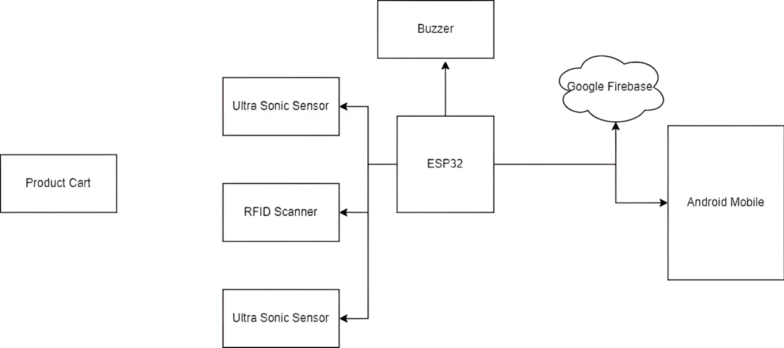
DFD Diagram :

Slide 15
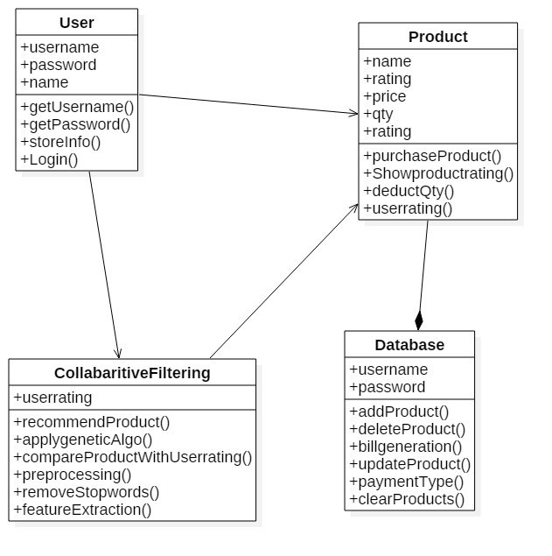
Class Diagram :

Slide 16
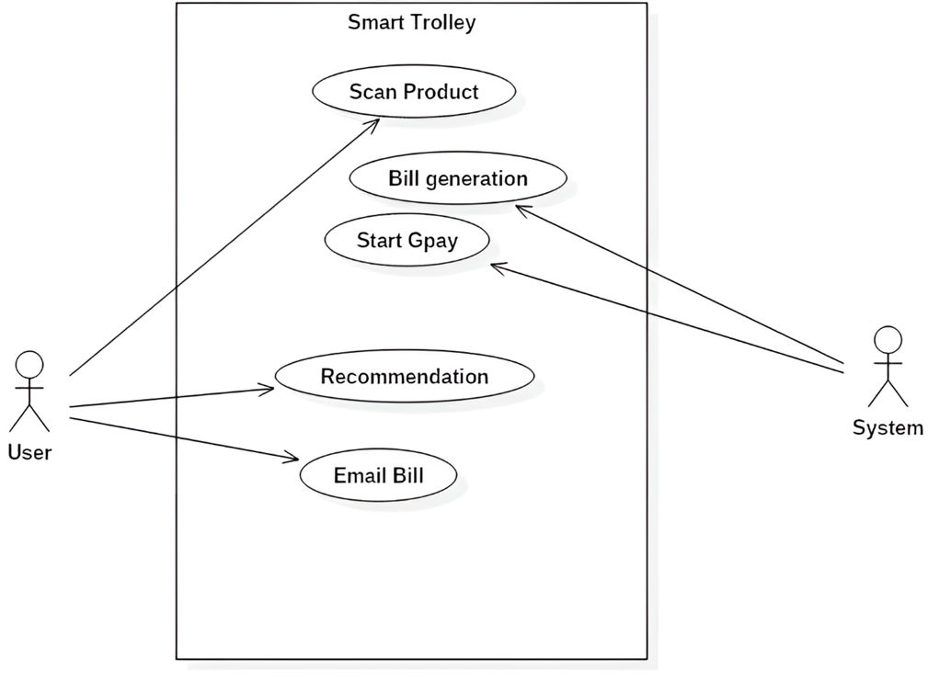
Use Case Diagram :

Slide 17
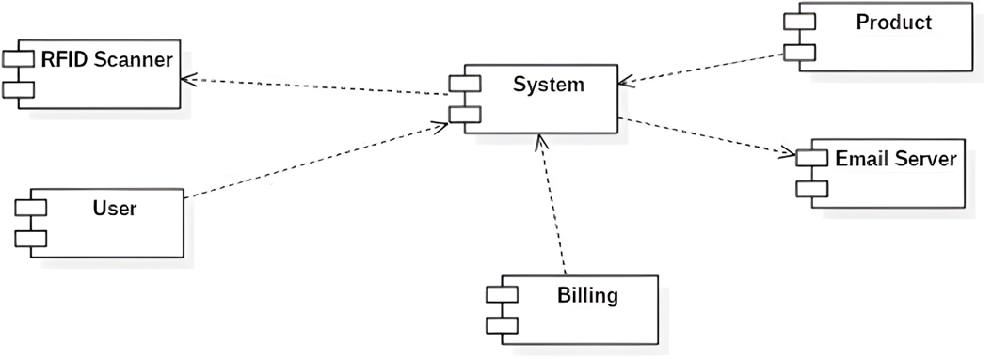
Collaboration Diagram :

Slide 18
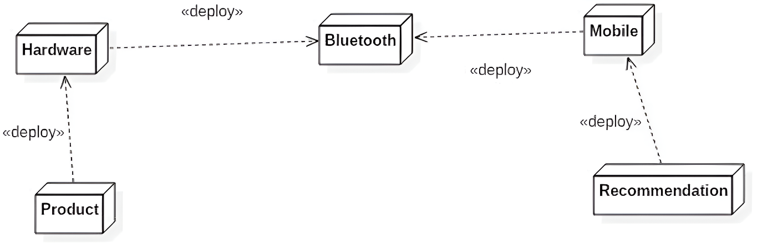
Deployment Diagram :

Slide 19
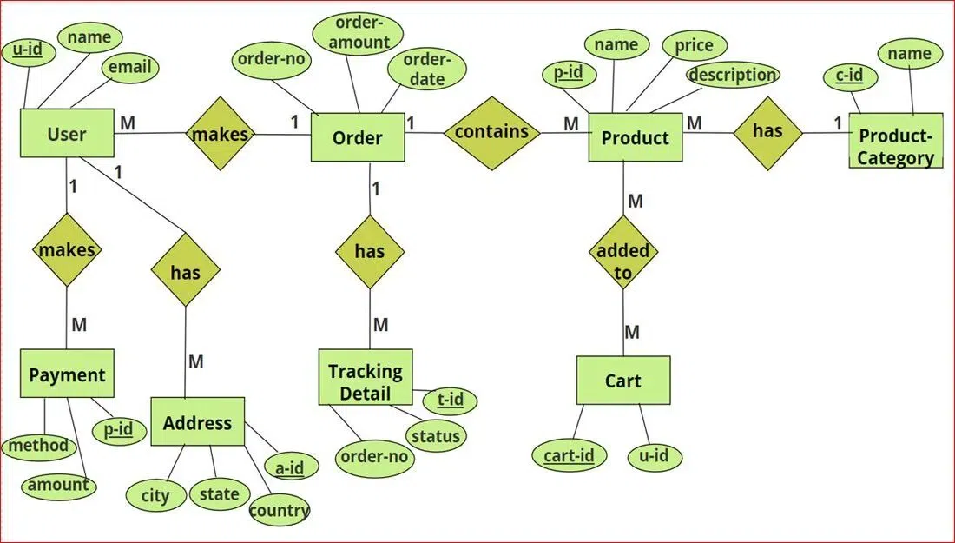
ER Diagram :

Slide 20
Collaborative Filtering Algorithm
Data Collection:
Gather user data, which typically includes user-item interactions (e.g., ratings, purchases, views).
Ensure the dataset is large enough to identify patterns and relationships between users.
Data Preprocessing:
Clean the data to remove duplicates, inconsistencies, and irrelevant entries.
Normalize the ratings (e.g., adjusting for different rating scales) if necessary.
Similarity Calculation:
Choose a similarity metric to measure how alike users are. Common metrics include:
Cosine Similarity: Measures the cosine of the angle between two vectors.

Slide 21
Expected Outcome
A. Customer Registration and Login
The customer has to first create his account on the app. The customer details will be saved on the web server.
B. Shop Database Maintenance
The shop database will contain all the data regarding each component. This is where the information about the product will be stored and manipulated. The customer's account data as well as the billing data will also be stored here.
C. Shopping Cart Selection
Once the user logs in to the mobile app they will have a prompt to scan available shopping carts. The shopping carts will be identified will an SSID with a specific pattern. Once the user has scanned all the carts he can select a specific one. Once selected the mobile phone will be connected to that shopping cart bluetooth enabling them to communicate with each other.
D. Shopping with the Shopping Cart and the Mobile App
Once the mobile app and the shopping cart are connected through bluetooth the customer can start with the shopping operations.

Slide 22
Advantages
Helping you to quickly navigate the store and easily locate the items you want.
Eliminating the need to line up during checkout.
Reducing the time it takes to scan items.
The scanning happens automatically as you place items in the cart.

Slide 23
Limitation
Children can't sit on the smart shopping cart.
Hardware cost and Maintenance.

Slide 24
Future Scope
We are developing android app, In future we will develop IOS app.
Integrating online shopping as well.

Slide 25
Conclusion
A smart cart represents a significant advancement in retail technology, offering a range of benefits that enhance both the shopping experience and operational efficiency.
By integrating features such as automated checkout, real-time navigation, and personalized assistance, smart carts aim to streamline the shopping process, making it more convenient and efficient for consumers.

Slide 26
Thank You .

